Slide 1
Introduction to Data Science
Steven Gollmer, Dept. Science and Mathematics
John Delano, School of Business
Mark Gathany, Dept. Science and Mathematics
Ashley Holland, Dept. Science and Mathematics
Tim Tuinstra, School of Engineering
Cedarville University
(September 11, 2017)

Slide 2
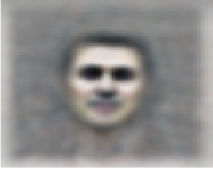
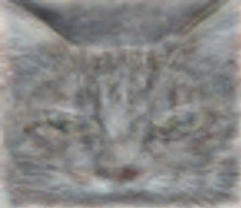
Google Brain
Use deep learning techniques to solve the problem of Artificial Intelligence
Began as a closed source project called DistBelief.
Open source version is called TensorFlow.
Tensor Processing Units developed for data centers
Unsupervised Learning in 2012
16,000 processor cores
10 million random YouTube thumbnails
Neural network with 1 billion connections
81.7% accurate at detecting faces
74.8% accurate identifying cats
Goal – Develop a universal AI machine (any information anywhere)
Notes:
https://en.wikipedia.org/wiki/Google_Brain
https://research.google.com/teams/brain/
Building High-level Features Using Large Scale Unsupervised Learning, International Conference on Machine Learning, Edinburgh, June 26, 2012 - https://arxiv.org/pdf/1112.6209.pdf

Slide 3
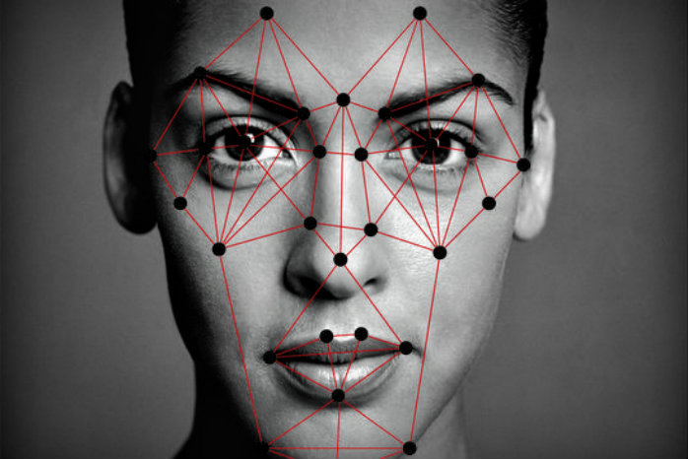
Auto-tagging Photographs
Facial recognition software is used to group photos together and suggest who should be tagged.
Law enforcement databases
Super Bowl XXXV – Fans faces scanned and 19 individuals with outstanding warrants were identified.
50% of U.S. adults have photo of face in at least one database used by police facial-recognition systems.
Facebook’s DeepFace
Uses a nine-layer neural net.
Trained on 4,000 face using 4 million images
Has an accuracy of 97%.
Notes:
Super Bowl XXXV was held in Tampa and resulted in the Ravens defeating the Giants. Took place in January 2001.
50% adults have photos in police databases. From Atlantic article Oct. 19, 2016
Image from - https://www.cato.org/blog/dhs-dont-want-face-scanned-dont-travel

Slide 4
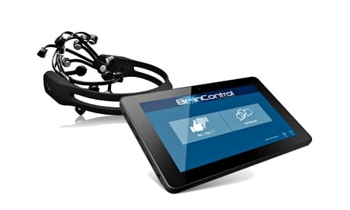
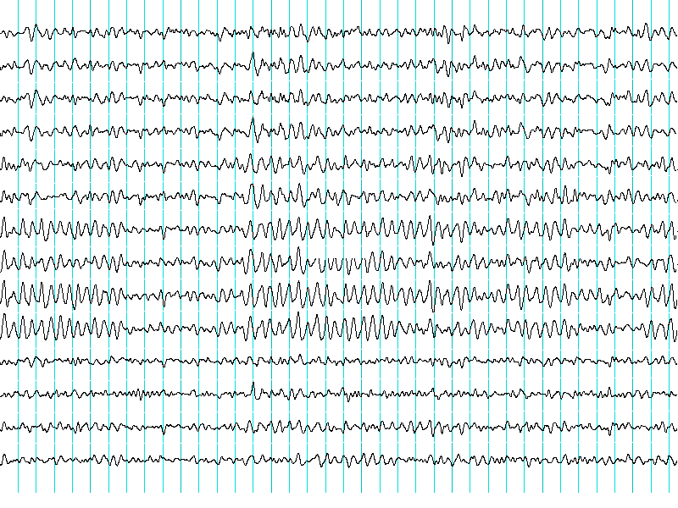
Brain Waves
EMOTIV Epoc
14 channel wireless electroencephalograph (EEG)
Saline based wet sensors
Mental Control
First establish baseline response to brainwaves.
Train software while concentrating on performing an action.
Machine-learning algorithm used to associate brain wave signals to action.
See Ted Talk by Tan Le
Notes:
https://www.ted.com/talks/tan_le_a_headset_that_reads_your_brainwaves
http://www.wired.co.uk/article/mind-control
https://www.theguardian.com/technology/2014/jul/11/kickstarter-headset-locked-in-syndrome-communication
Encephalograph image from - https://en.wikipedia.org/wiki/Brain%E2%80%93computer_interface

Slide 5
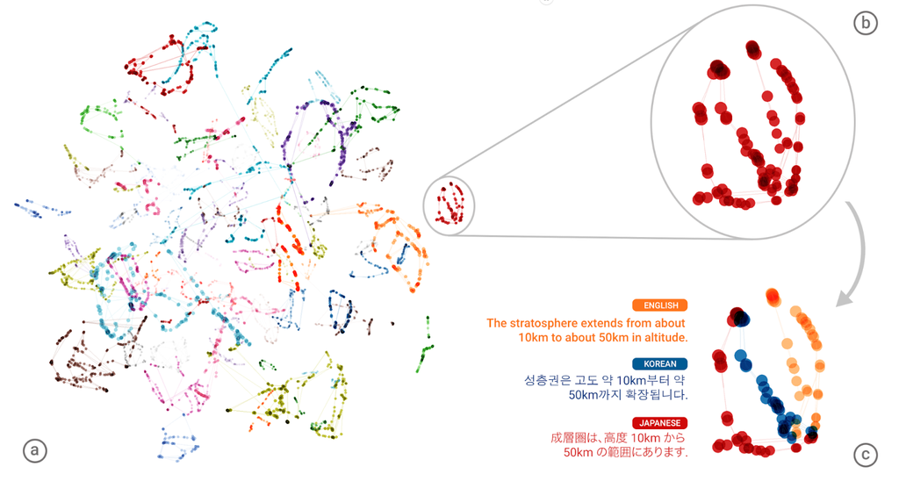
Google Neural Machine Translation System
How do you put together a language translator program?
Word by word translation
Exceptions for idioms
Validate grammar
Done as a 1-1 mapping of languages
Neural Machine Translations
Google switched to this Nov. 16, 2016
Included 8 language pairs
Appears to form a “interlingua”
Representation recognizes sentence and word similarities between languages.
Cut down errors by 55 – 85%
Notes:
https://research.googleblog.com/2016/11/zero-shot-translation-with-googles.html
https://www.ghacks.net/2016/11/17/google-translate-switches-to-neural-machine-translations/

Slide 6
What is Data Science?
Definition
Data science, also known as data-driven science, is an interdisciplinary field about scientific methods, processes, and systems to extract knowledge or insights from data in various forms, either structured or unstructured, similar to data mining. (Wikipedia)
“The key word in ‘Data Science’ is not Data, it is Science” (Jeff Leek)
Analytics, Data Mining, Neural Nets are just tools for managing and exploring “Big Data.”
Are you trying to answer interesting questions?
The trap is focusing on a collection of techniques or tools.
The goal is to extract a better understanding of a system.
These techniques can be used to engineer solutions.
Notes:
https://simplystatistics.org/2013/12/12/the-key-word-in-data-science-is-not-data-it-is-science/

Slide 7
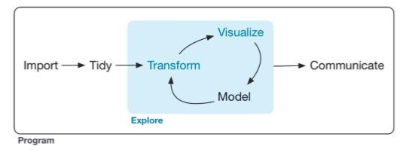
What do data scientists do?
Expectations (Most important skills of data scientists, TEDx talk)
Answers in days rather than months
Exploratory analysis and rapid iteration
Visual representation to enhance insight
Turn data into actionable insight
R for Data Science (p. 1)
Notes:
TEDx reference from Wikipedia: Data Science, reference 26.
Diagram from R for Data Science by Wickham and Grolemund

Slide 8
Data Science Tools
Statistical Programs and Platforms
Open Source Programs and Platforms
Visualization Programs

Slide 9
Data Science Seminars
Format
Meet monthly (Monday evening)
Presentation of concept and/or tool with examples
Workshop assisting you to recreate the examples
Background
Basic understanding of statistics
Basic programming skills
Possible Topics
Using R for data science
Data structures and queries using SQL
Opinion mining from text based sources
Geospatial analysis
Pattern recognition
Neural Networks
Data visualization

Slide 10
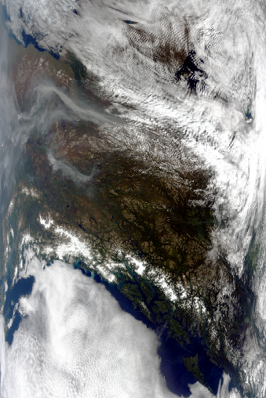
MODIS – 36 Channels (Clustering Analysis)
Steven Gollmer, PhD, Professor of Physics, ENS 357
Notes:
MODIS is a medium resolution sensor mounted on two satellites (TERRA, AQUA)

Slide 11
My interest in Data Science – Steve Gollmer
Experience and skills
Fourier Transform, Wavelet Analysis
Empirical orthogonal functions (EOF’s), Principle Component Analysis (PCA)
Programming in C++, Java and R
Implications to science and philosophy
Can machine learning make novel scientific discoveries?
How can machine learning enhance the pursuit of science?
What unique abilities do humans contribute to discovery?
Can deep learning techniques achieve artificial intelligence?
If AI is achieved, is it through accumulated order from massive data or deliberate design?

Slide 12
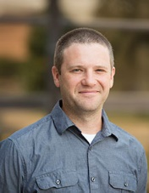
spatial data (objects & Imagery) + geographic Information systems
solutions
Collect. Store. Manage. Analyze.
Mark Gathany, phD Associate Professor Ecology & Environmental Science ENS 277
pbs.twimg.com
Notes:
GIS, remote sensing, drones and spatial analysis

Slide 13
My interest in Data Science – John Delano
Experience and skills
Structured Query Language (SQL)
Service-oriented analysis and design
Data mining (particularly requirements matching and sentiment analysis)
Programming in C# and Java
Implications to practice
Business intelligence – providing actionable information at the right time/place/format
System design – locate and reuse existing functionality built into web services
Understanding customer needs – is this review on Amazon favorable?
“After I used product XYZ for a few months, I was so disappointed …”
“… that I didn’t purchase this product sooner!”

Slide 14
My interest in Data Science – Tim Tuinstra
Experience and skills
Matlab, C++, Java
Statistical Pattern Recognition, Statistical Signal Processing
Neural Networks, Fuzzy Systems, Computational Intelligence, Clustering
Transforms of all Kinds (Fourier, Wavelets, Cosine, etc.)
Implications to Engineering
Pattern Recognition in Signals & Imagery
Image Processing Applications
Radar Applications
Medical Applications

Slide 15
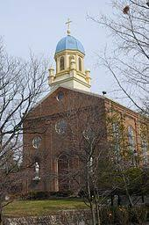
Less Recent Data Science Work - Tuinstra
Lung Cancer Volume Estimation
using Neural Networks

Slide 16
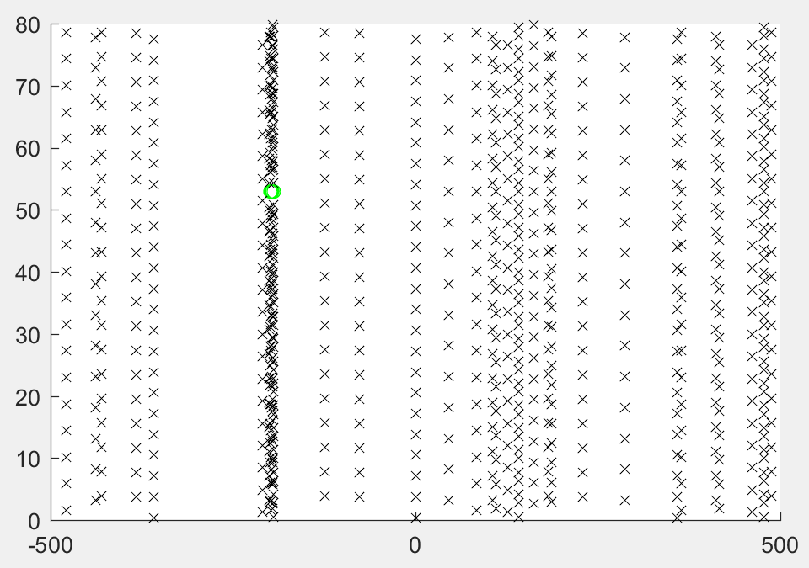
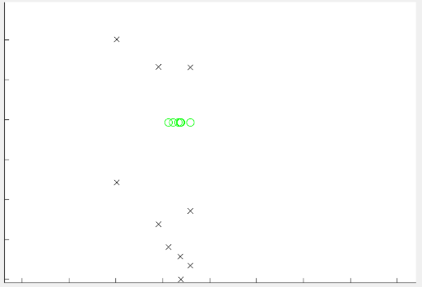
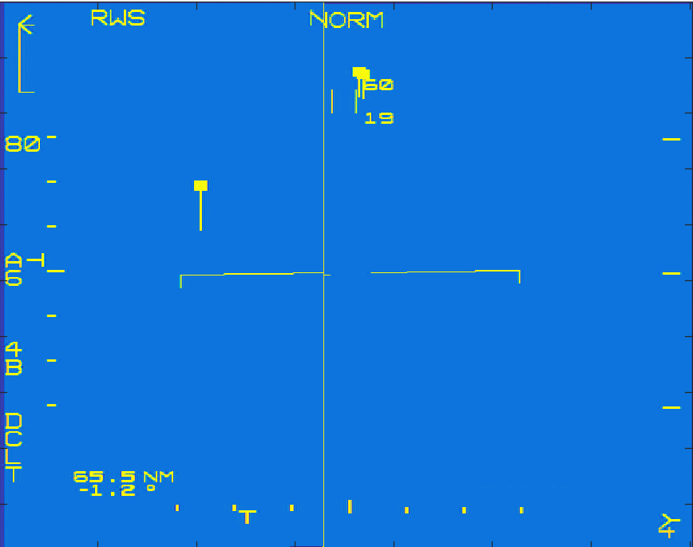
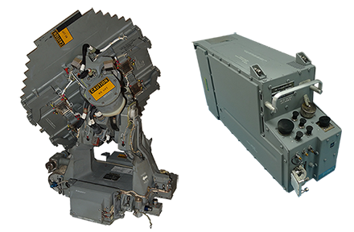
Recent Data Science Activities - Tuinstra
DBSCAN Clustering for
Radar Disambiguation
Range
(nmi)
Range
(nmi)
Velocity (kts)

Slide 17
Econometrics
Examples
Econometrics
Ashley Holland
Examples Regression
Econometrics uses mathematics and statistics to describe economic relationships based on data.
Typical examples:
Determining the effect of a job training program on the worker’s wages (program evaluation)
Describing the effect of school spending on student performance
Forecasting interest rates and inflation rates (time series)
Density Estimation
Time Series
Fall 2017

Slide 18
Regression
Regression
Econometrics
Ashley Holland
Examples
Regression
y = β₀ + β₁x₁ + ... + β_{k} x_{k} + u, where E[u|x ] = 0
n observations of x₁, ..., x_{k} , y
Goal: Estimate β₀, .., β_{k} with minimum error
Least squares estimation
Regression
Density Estimation
Time Series
n
(x_{i} − x¯)(y_{i} − y¯)
ˆ
i =1
β₁ =
n i =1
(x − x¯)
2
i
Bias (e.g. Eβ^{ˆ}₁ = β₁)
Consistency (e.g. lim β^{ˆ}₁ = β₁)
n→∞
Efficiency (lowest standard error)
Fall 2017

Slide 19
Density Estimation
Density Estimation
Econometrics
Ashley Holland
Examples Regression
Density estimation
Goal: Given a set of data, estimate the probability density function f of one of the variables
Density Estimation
Time Series
$\int_{S}{f\left(x\right)dx}$ (= P(X ∈ S )
Nonparametric methods Kernel estimation Series estimation
Fall 2017

Slide 20
Time Series
Time Series
Econometrics
Ashley Holland
Examples Regression
Time series
Observations over time
Panel data (many observations, many time values)
Density Estimation
Time Series
Examples
Forecasting Stock market
Measures of health over many years GDP
Fall 2017

Slide 21
Questions
When is the next seminar?
Haven’t decided yet, but early October would be a good target.

