Slide 1
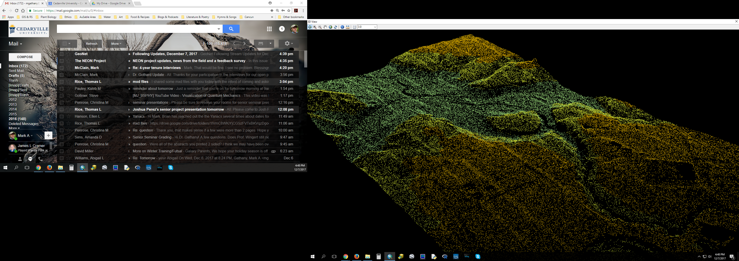
Geographic Information Systems (GIS)
Mark Gathany, phD
Associate Professor
Ecology & Environmental Science
ENS 277
Modern cartography, data management, and spatial analysis

Slide 2
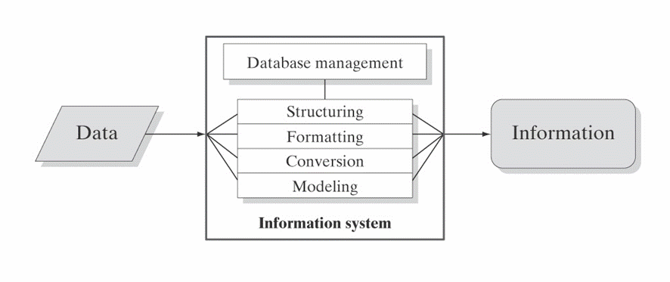
An information system
Why geographic information system?

Slide 3
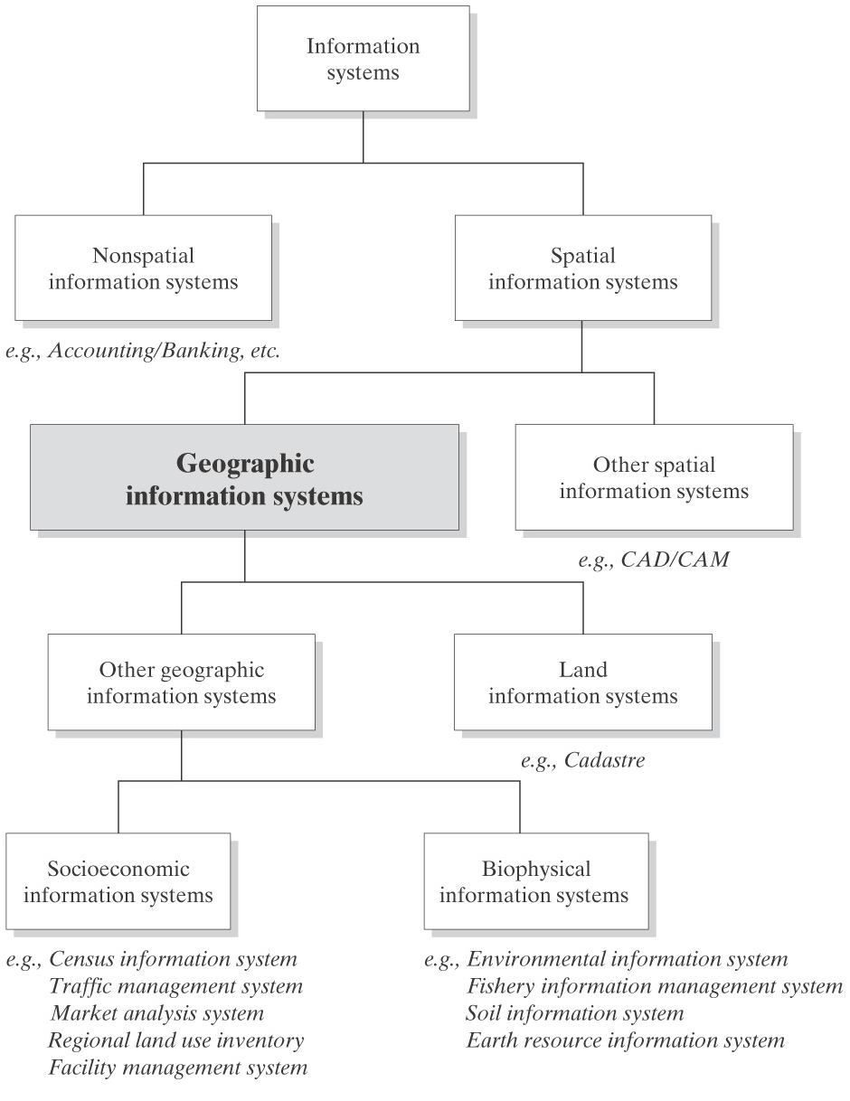
Collect.
Store.
Manage.
Analyze.

Slide 4
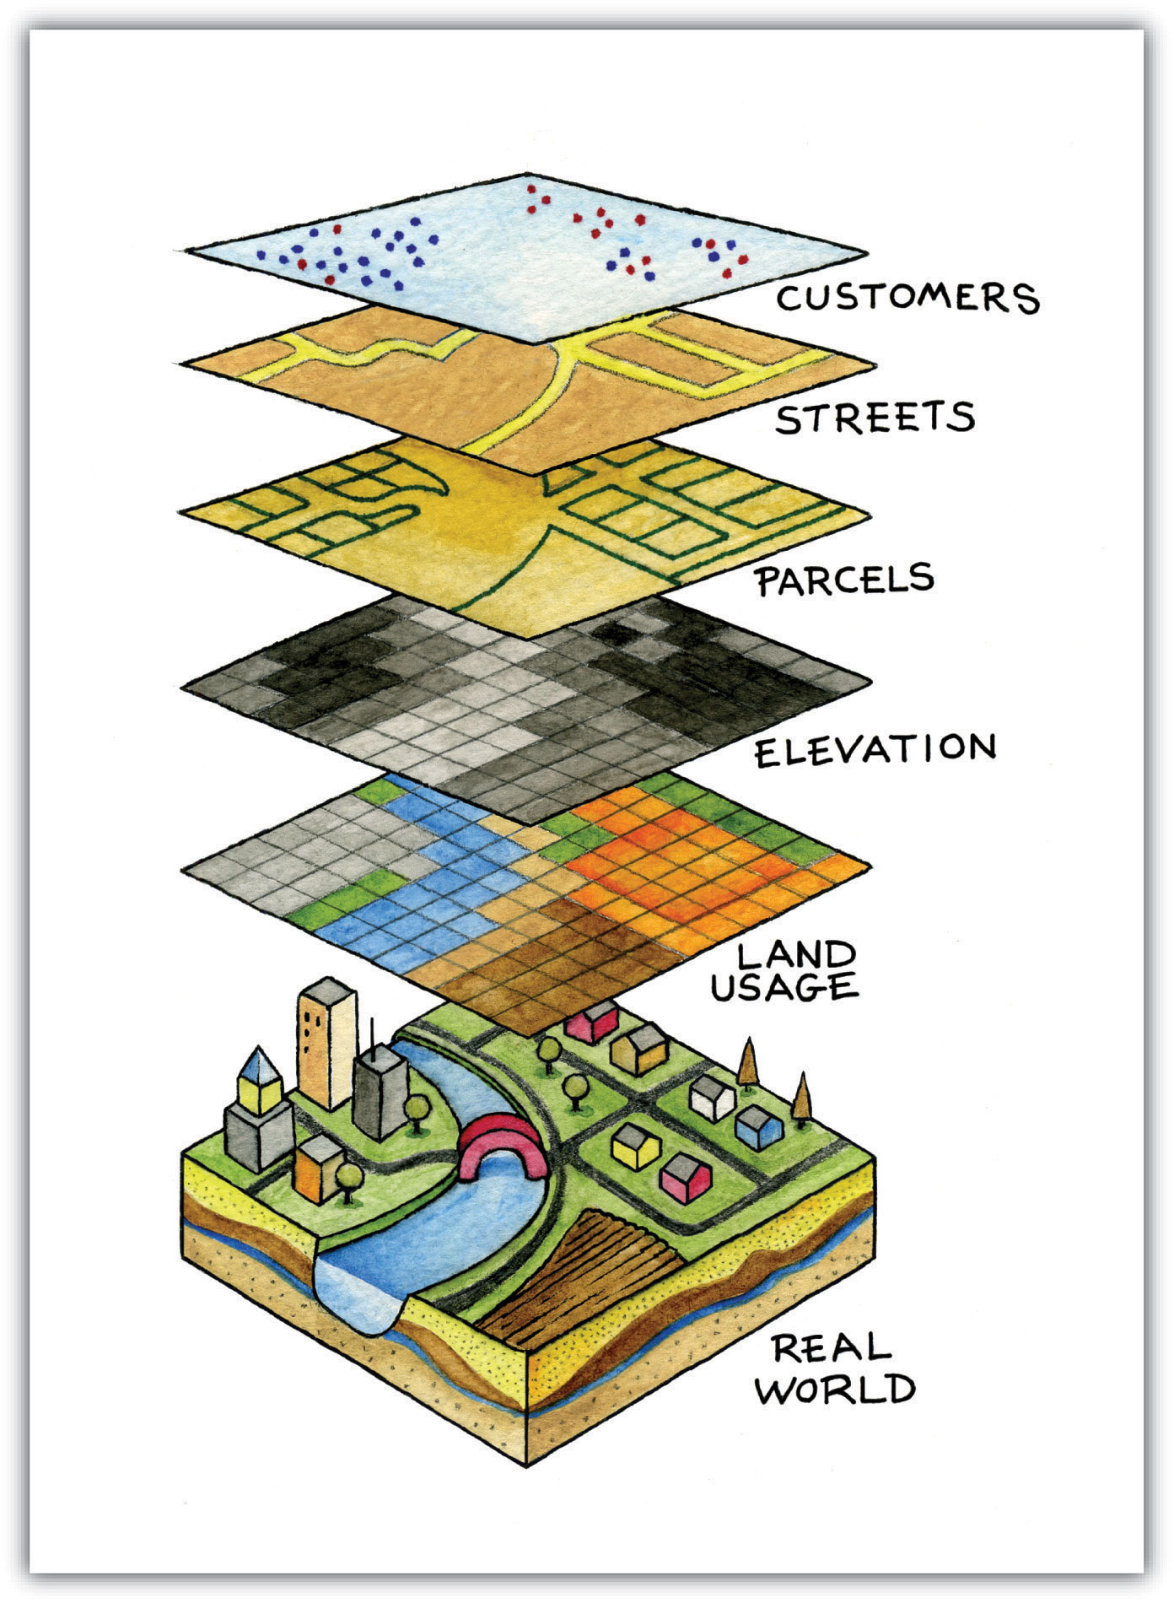
What is a GIS?
A tool to digitally abstract the real world
Information is connected to its physical location and organized into layers.
Software & hardware is used to display, organize, store, manage, and analyze this data.
GIS is dominated by Esri software (e.g. ArcMap, ArcCatalog, etc.)

Slide 5

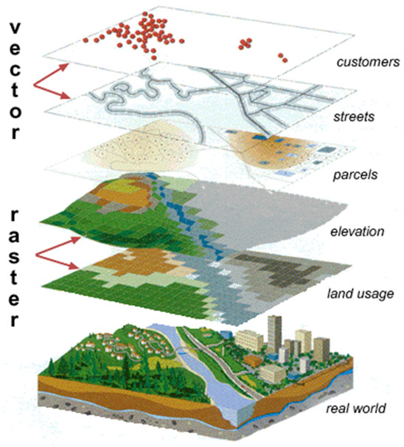
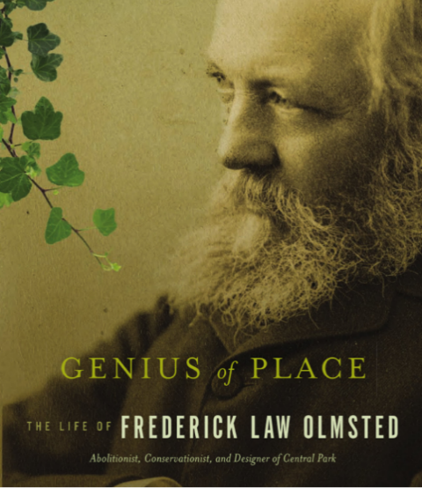

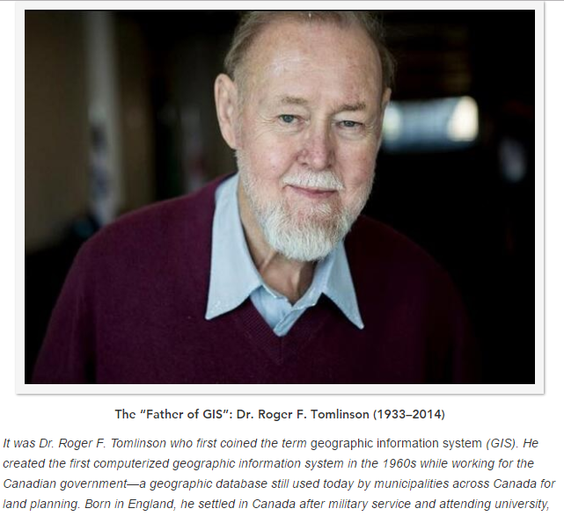
Genesis of GIS…necessity (and opportunity) is the mother of invention.
GIS’s origins lie in thematic cartography
Born out of urban planners and natural resource conservationists that used the method of manual map overlay (combining various themes)
Manual map overlay as a method was first described comprehensively by Jacqueline Tyrwhitt in a 1950 planning textbook
McHarg used blacked out transparent overlays for site selection in Design with Nature
Tomlinson develops first computer based GIS for analysis of Canadian forests.

Slide 6

Defining GIS
Different definitions of a GIS have evolved in different areas and disciplines
All GIS definitions recognize that spatial data are unique because they are linked to maps (space matters!)
A GIS at least consists of a(n):
  Informaiton database
  Map information
  Computer-based link between them
Nighttime in Paris

Slide 7
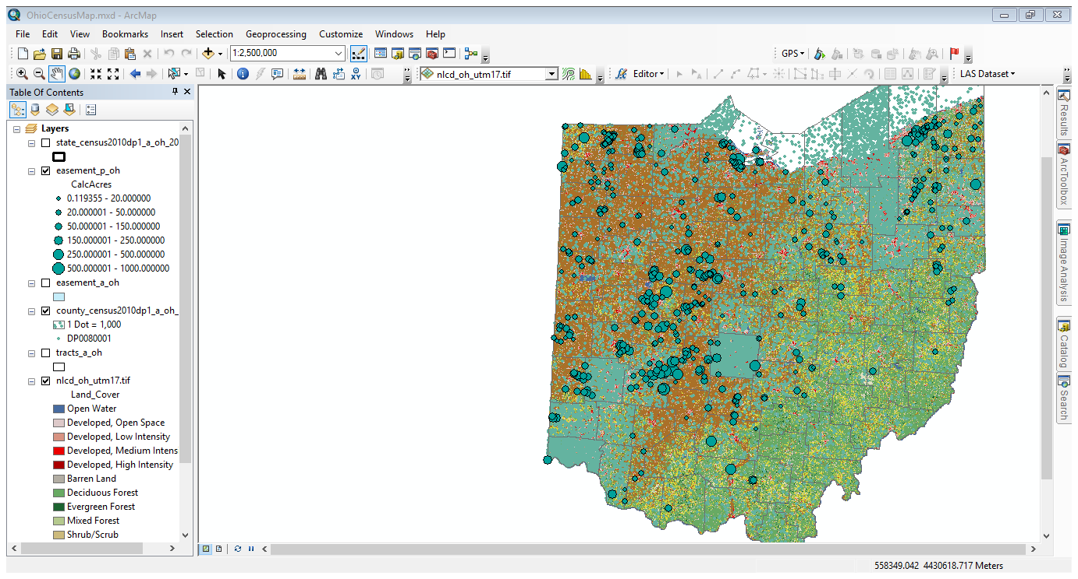
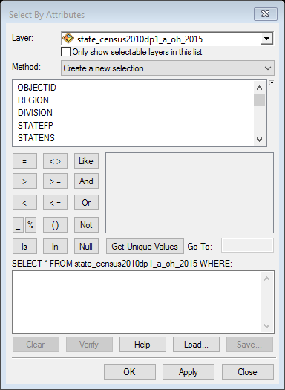
The workspace(s)

Slide 8
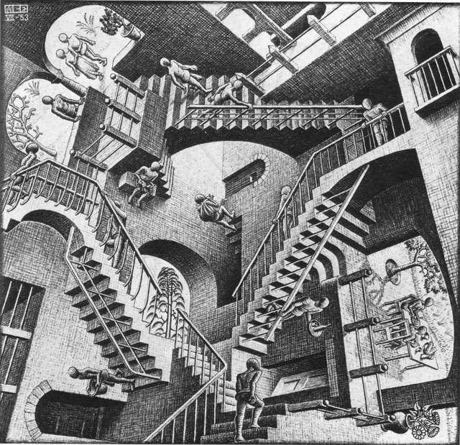
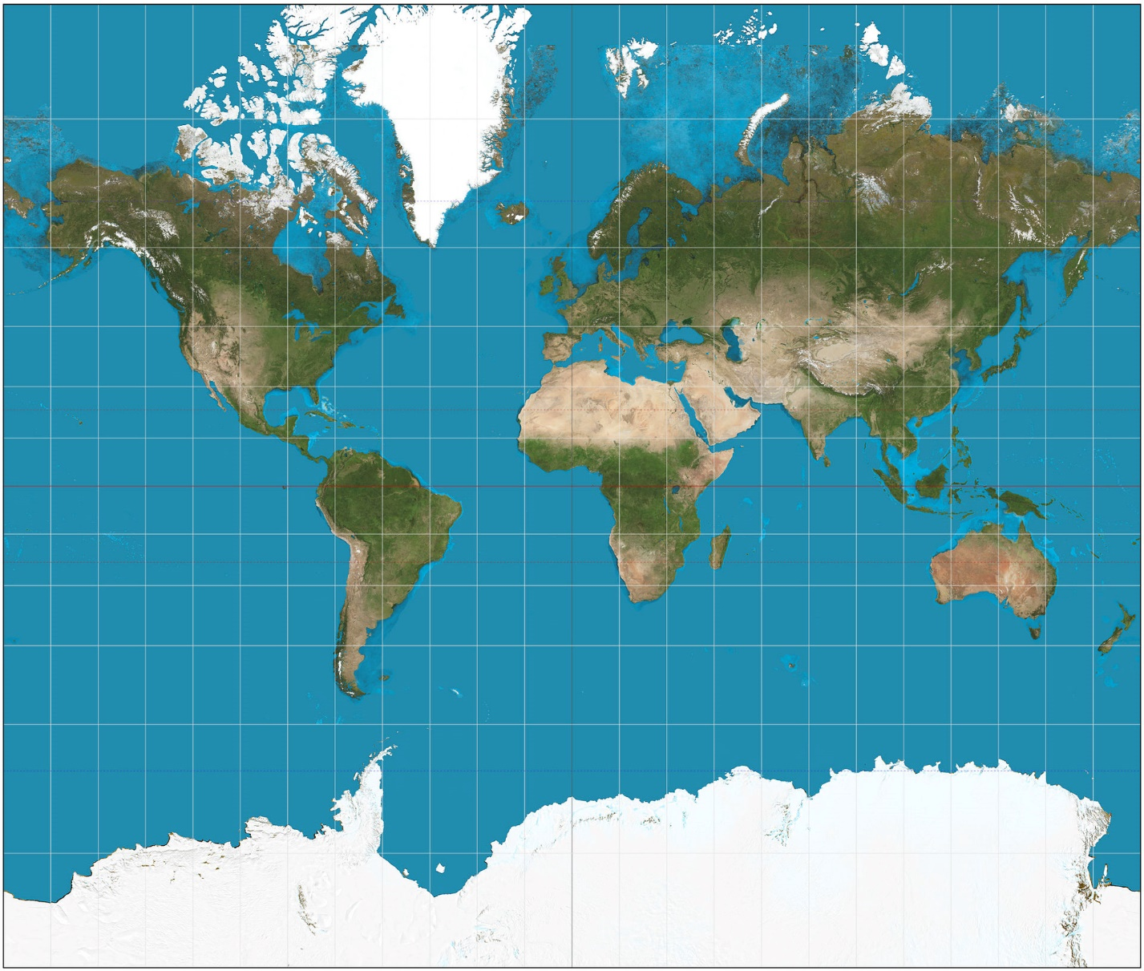
Models of the Earth
The earth can be modeled as a
  sphere
  oblate ellipsoid
  geoid
A map is a model!
A model is an abstraction of reality!!!

Slide 9
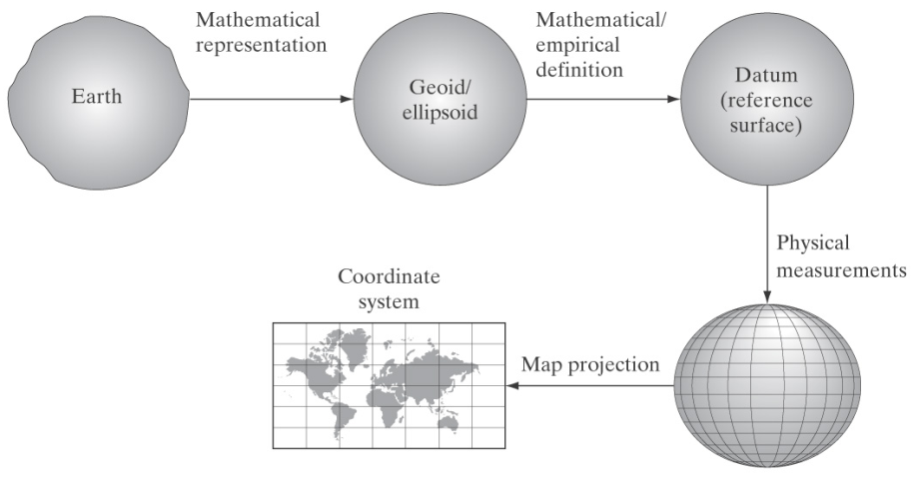
Putting a little [necessary] geography into GIS…

Slide 10
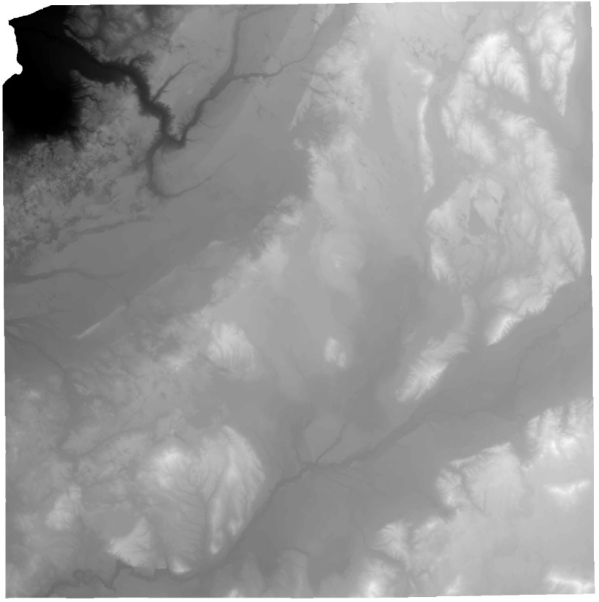
Map data models
Vector
object, or feature-based, discrete points, lines, and areas. Field collections.
Raster
a grid of cells containing one value per pixel. Remotely sensed imagery or modeled.
Surface
a sort of raster-vector hybrid with the unique capacity to display 3D data. LiDAR and TINs.
Cedarville University & surrounding area: parcels and tree inventory
Digital Elevation Model (DEM) of Kalkaska County, Michigan
LiDAR point cloud of Indian Mound Reserve, Cedarville, Ohio

Slide 11
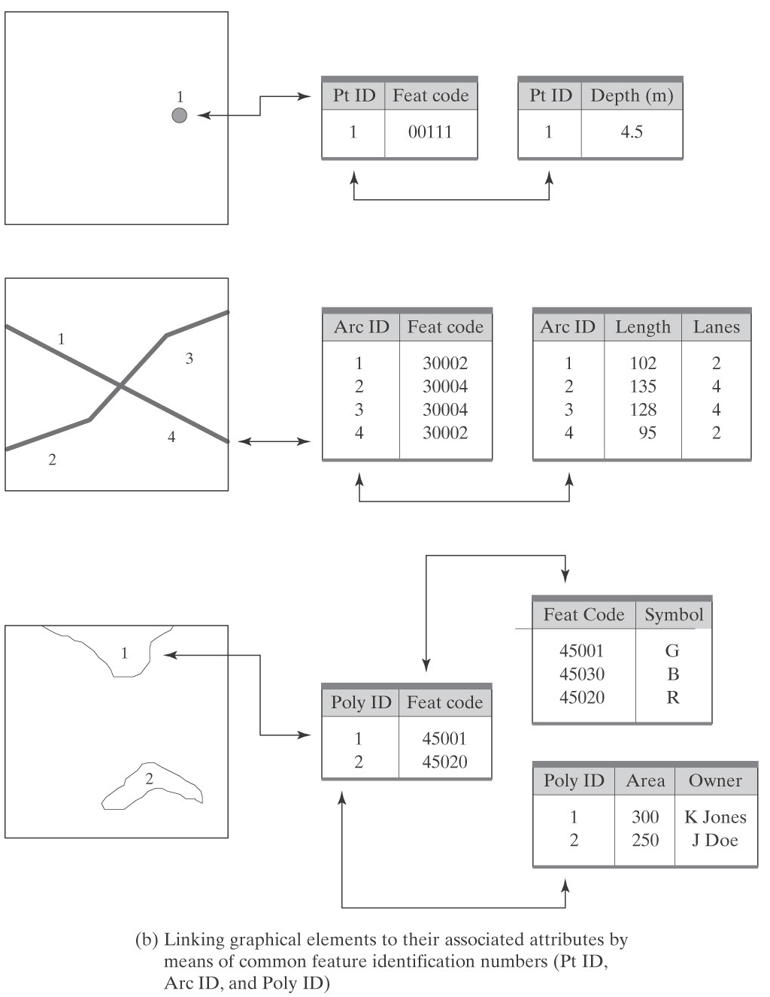
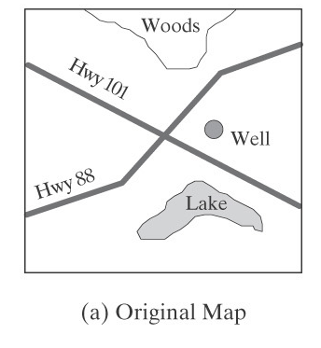
Vector model
Originally developed from the arc-node (point-line) model
Basic premise:
  An area…
  is lines…
  is points…
  that have coordinates.
We typically describe things in greater detail than…point…line…

Slide 12
The GIS Database
We manage database information by theme, or layer (e.g. trees, bedrock, etc.)
Layer attributes are stored in the attribute table as column headers
Records (unique objects) are stored as rows.
The contents of an attribute for one record is a value.
A value can be numerical or text.
 | Attribute 1 | Attribute 2 | Attribute 3
1 | [value] | [value] | [value]
2 | [value] | [value] | [value]
. | … | … | …
. | … | … | …
. | … | … | …
n | [value] | [value] | [value]
record

Slide 13
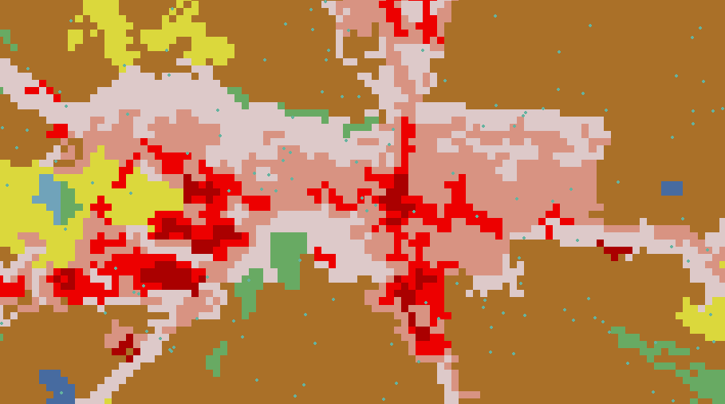
Raster & surface models
Rasters are square tessellations, or grids
Each grid cell has one, and only one, value (though we may join tables on this information)
At least two grid cells must have coordinates
Common rasters are:
  DEM (digital elevation model) each cell has an elevation
  LULC (land use land cover) each cell has value corresponding to dominant vegetation/cover
My house…
…well actually the grid cell in which my house is located that is “medium intensity developed”

Slide 14
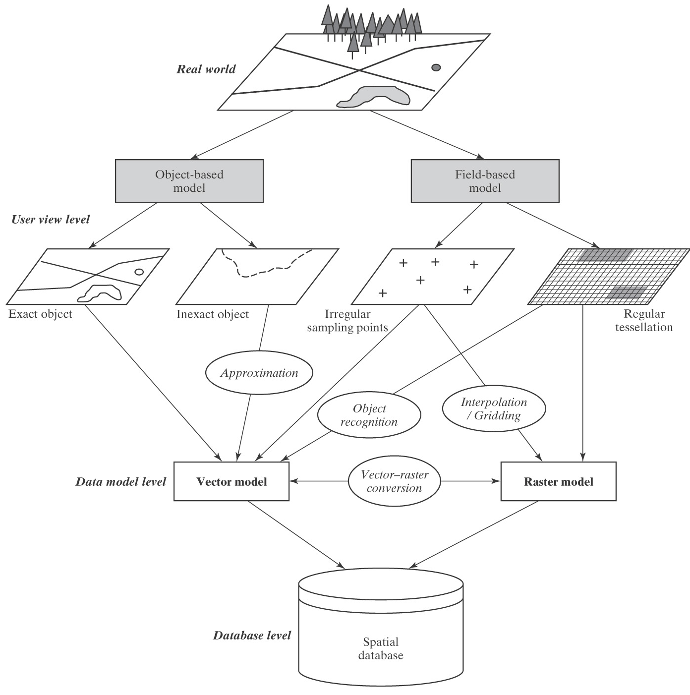
So what is a map?
A map is an abstraction of the real world

Slide 15
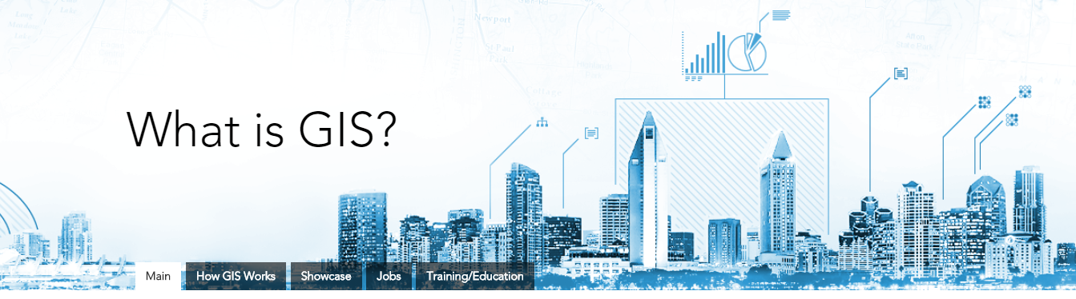

The power of mapping
Cost savings from greater efficiency
  package delivery routes
Better decision making
  disaster relief and prevention
Improved communication
  placed-based storytelling
Better record keeping
  asset management
Managing geographically
  planning, modeling, developing

Slide 16
Your turn…
Write down five things “spatial things” here on campus…
Share with a neighbor.
Could you depict these in a map? As features (points, lines, or areas)? As surfaces?
How would you collect information about these features? Get it into a computer?
What information would you collect?
Among the layers you have…what questions could you ask about the relationships?

Slide 17
Upcoming opportunities…
SU 2018 – participation in NSF Macrosystems Study.
Can we estimate biodiversity from remotely sensed imagery?
SU 2018 – Au Sable Institute
I teach Land Resources (GIS portion) and Environmental Applications for GIS
FA 18 – ENVS 2100 – Principles of GIS
Introduction to modern cartography and use of GIS to display, store, manage and analyze spatial data. Also includes the acquisition and use of GPS and Landsat data.
SP19 – BIO 4880 – Spatial Analysis
Topics & Techniques: advanced GIS & spatial analysis, geodatabase design, drone imagery, LiDAR, imagery processing, and remote sensing.

Slide 18
Practice
The Ohio Census Data, Conservation Easements, and LULC.
Talk to me about your interests/applications/questions
GPS unit (or phone with TrackKit) and output to Google Earth or ArcMap
Advanced
  Various workbook chapters and datasets from geodatabase design to remote sensing
  Can we use GIS to predict West Nile Virus?
  What urban centers are at risk if the Ogallala Aquifer is emptied?

