Slide 1
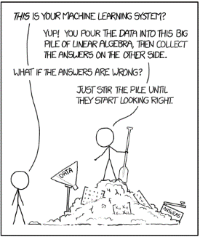
Artificial Intelligence: Past, Present and Prospects
Steven Gollmer, Dept. Science and Mathematics
Cedarville University
(October 1, 2018)
Machine Learning, xkcd #1838

Slide 2
Data Science Working Group
Members
Steven Gollmer, Dept. Science and Mathematics
John Delano, School of Business
Mark Gathany, Dept. Science and Mathematics
Tim Tuinstra, School of Engineering
Ashley Holland, Dept. Science and Mathematics
Goals
Conduct data science seminars
Develop data science resources for students, faculty and staff

Slide 3
What is Data Science?
Definition
Data science, also known as data-driven science, is an interdisciplinary field about scientific methods, processes, and systems to extract knowledge or insights from data in various forms, either structured or unstructured, similar to data mining. (Wikipedia)
“The key word in ‘Data Science’ is not Data, it is Science” (Jeff Leek)
Analytics, Data Mining, Neural Nets are just tools for managing and exploring “Big Data.”
Are you trying to answer interesting questions?
The trap is focusing on a collection of techniques or tools.
The goal is to extract a better understanding of a system.
These techniques can be used to engineer solutions.
Notes:
https://simplystatistics.org/2013/12/12/the-key-word-in-data-science-is-not-data-it-is-science/

Slide 4
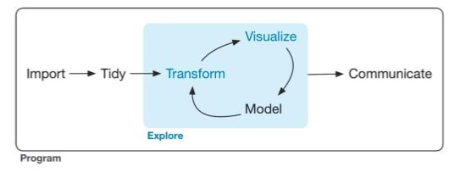
What do data scientists do?
Expectations (Most important skills of data scientists, TEDx talk)
Answers in days rather than months
Exploratory analysis and rapid iteration
Visual representation to enhance insight
Turn data into actionable insight
R for Data Science (p. 1)
Notes:
TEDx reference from Wikipedia: Data Science, reference 26.
Diagram from R for Data Science by Wickham and Grolemund

Slide 5
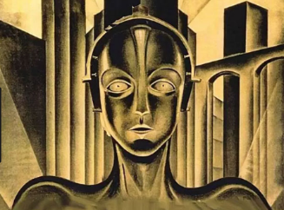
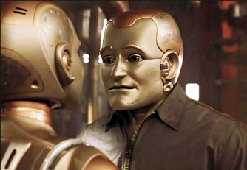
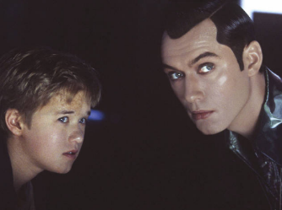
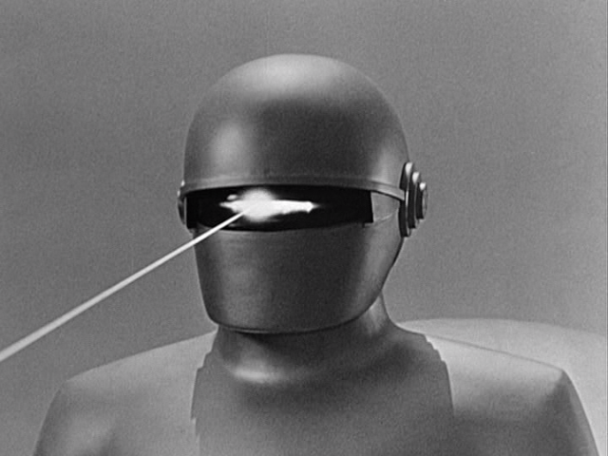
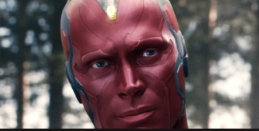
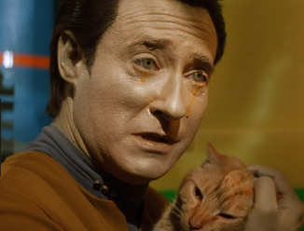
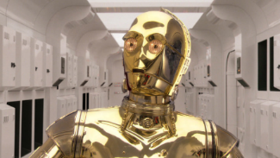
Notes:
Images are most likely copyrighted
Maschinenmensch – Metropolis
Andrew Martin – Bicentennial Man
David and Joe – A.I. Artificial Intelligence
Vision – Avengers: Age of Ultron
T-800 Model 101 – The Terminator
C3PO – Star Wars
Data – Star Trek: The Next Generation
Klaatu – The Day the Earth Stood Still

Slide 6
Cybernetics
From Greek word meaning “governance.” (Steer, navigate, govern)
Cybernetics: Or Control and Communication in the Animal and the Machine.” Norbert Wiener (1948)
Study of teleological mechanisms
Macy Conferences (1941-1960) – Facilitate interdisciplinary scientific communication
Interdisciplinary field
Control systems, network theory, neuroscience, anthropology, psychology.
Dartmouth Summer Research Project on Artificial Intelligence
Organized by John McCarthy, 1956 – Develop ideas about thinking machines.”
Six week workshop
A.M. Turing (1950) Computing Machinery and Intelligence. Mind 49: 433-460.
Could a computer deceive a human during five minutes of text exchange?
“Are there imaginable digital computers which would do well in the imitation game?”

Slide 7
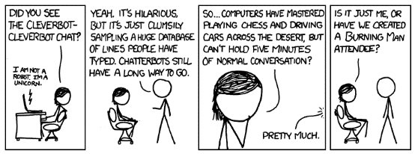
Artificial Intelligence
The study of and implementation of cognitive ability as demonstrated in humans.
Formally established as an academic discipline in 1956
Interdisciplinary in nature
Computer science
Mathematics
Psychology
Linguistics
Philosophy
Areas of study include
Reasoning
Knowledge representation
Planning
Learning
Natural language processing
Perception
Ability to move and manipulate objects
Long term goal is to demonstrate a “General Intelligence”
AI, xkcd #948

Slide 8
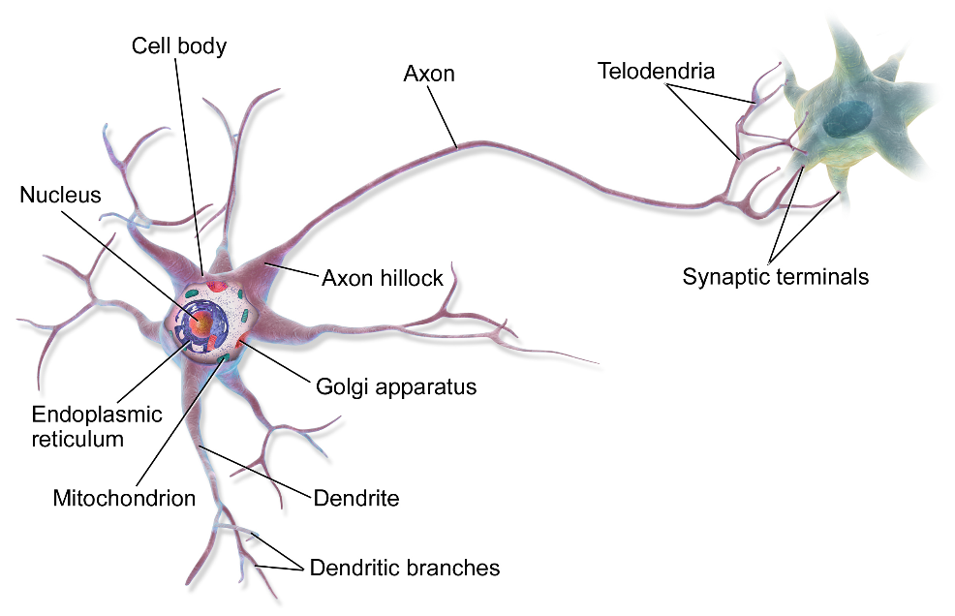
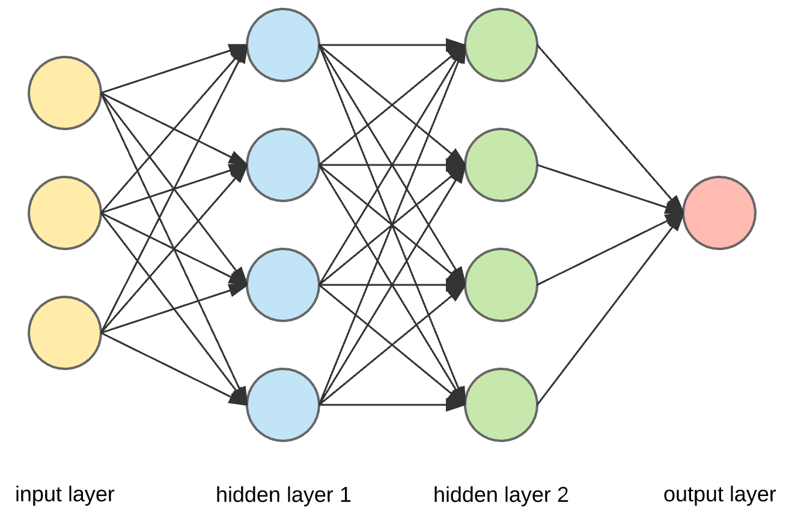
Approaches to AI
Connectionism
Use neural network logic, perceptrons (1950’s)
Backpropagation (1970’s)
Revived interest in neural networks due to backpropagation (mid 1980’s)
Symbolic Reasoning
Develop rules of deduction to produce general, human-like intelligence
General Problem Solver
Expert systems, LISP, Smalltalk
Statistical Learning (1990’s)
Hidden-Markov models and neural networks
Bayesian decision theory
Deep Learning (2010’s)

Slide 9
Cycles of Interest in Artificial Intelligence
AI Winter
Pessimism with regard to prospects of AI due to hype in the press, which leads to severe cutbacks in funding.
AI Revival
AI becomes predominant due to advancements in computer technology, improved algorithms and techniques.
Significant lulls in AI interest
1966 – Machine translation more expensive, less accurate and slower than human translation
1973 – Any useful problems suffer from intractability (Lighthill report)
1990’s – Expert systems expensive to maintain and brittle (unique conditions result in huge mistakes)
Notes:
See the following for more information
https://en.wikipedia.org/wiki/AI_winter#Early_episodes

Slide 10
Artificial Intelligence
Machine Learning
Deep Learning

Slide 11
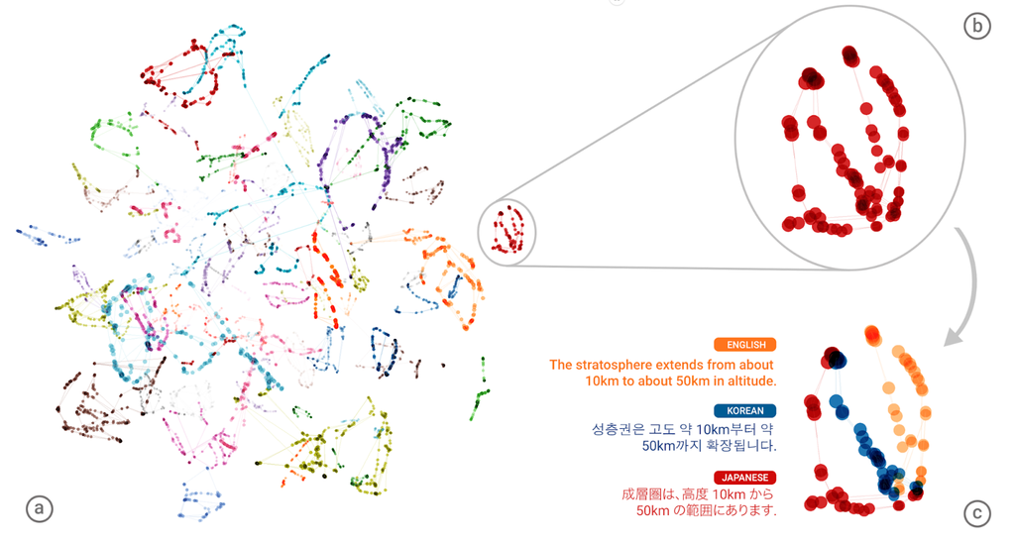
Google Neural Machine Translation System
How do you put together a language translator program?
Word by word translation
Exceptions for idioms
Validate grammar
Done as a 1-1 mapping of languages
Neural Machine Translations
Google switched to this Nov. 16, 2016
Included 8 language pairs
Appears to form a “interlingua”
Representation recognizes sentence and word similarities between languages.
Cut down errors by 55 – 85%
Notes:
https://research.googleblog.com/2016/11/zero-shot-translation-with-googles.html
https://www.ghacks.net/2016/11/17/google-translate-switches-to-neural-machine-translations/

Slide 12
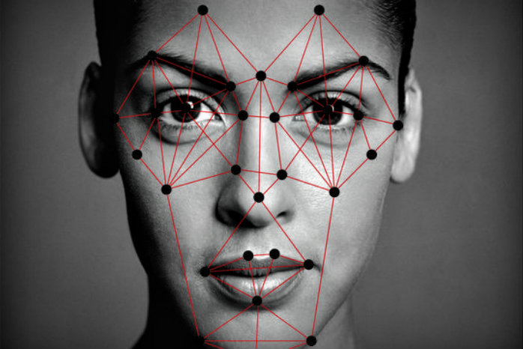
Auto-tagging Photographs
Facial recognition software is used to group photos together and suggest who should be tagged.
Law enforcement databases
Super Bowl XXXV – Fans faces scanned and 19 individuals with outstanding warrants were identified.
50% of U.S. adults have photo of face in at least one database used by police facial-recognition systems.
Facebook’s DeepFace
Uses a nine-layer neural net.
Trained on 4,000 face using 4 million images
Has an accuracy of 97%.
Notes:
Super Bowl XXXV was held in Tampa and resulted in the Ravens defeating the Giants. Took place in January 2001.
50% adults have photos in police databases. From Atlantic article Oct. 19, 2016
Image from - https://www.cato.org/blog/dhs-dont-want-face-scanned-dont-travel

Slide 13
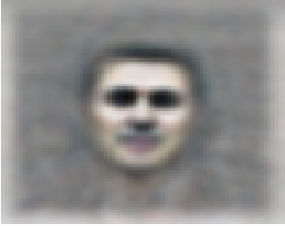
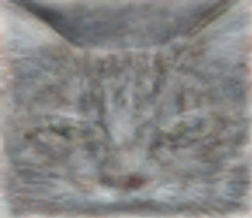
Google Brain
Use deep learning techniques to solve the problem of Artificial Intelligence
Began as a closed source project called DistBelief.
Open source version is called TensorFlow.
Tensor Processing Units developed for data centers
Unsupervised Learning in 2012
16,000 processor cores
10 million random YouTube thumbnails
Neural network with 1 billion connections
81.7% accurate at detecting faces
74.8% accurate identifying cats
Goal – Develop a universal AI machine (any information anywhere)
Notes:
https://en.wikipedia.org/wiki/Google_Brain
https://research.google.com/teams/brain/
Building High-level Features Using Large Scale Unsupervised Learning, International Conference on Machine Learning, Edinburgh, June 26, 2012 - https://arxiv.org/pdf/1112.6209.pdf

Slide 14
Machine Learning as a Service (MLaaS)
Cloud services providing
Data preprocessing
Model training
Model evaluation
Major Players
Amazon ML (SageMaker – ML environment)
Microsoft Azure ML (ML Studio – ML environment)
Google Cloud AI (TensorFlow – Open source ML library)
Provide model training/deployment with little data science expertise
Notes:
Information for this page is synthesized from the following web site
https://www.kdnuggets.com/2018/01/mlaas-amazon-microsoft-azure-google-cloud-ai.html

Slide 15
Amazon ML
https://aws.amazon.com/free/

Slide 16
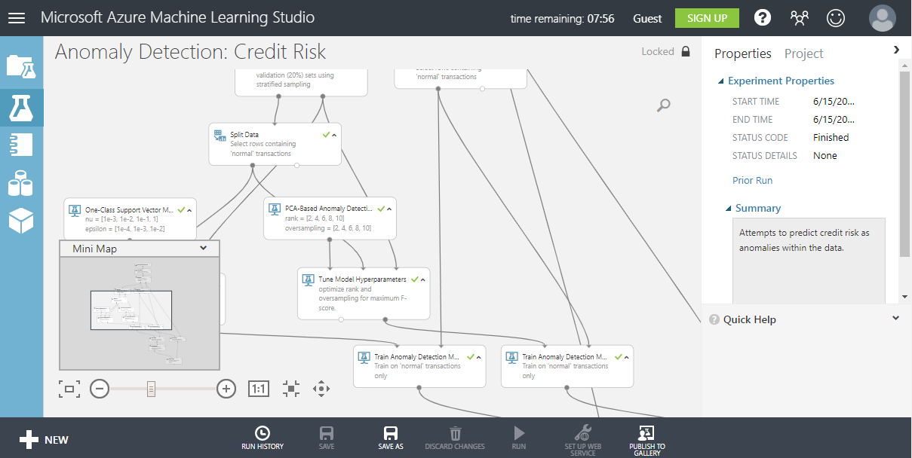
Azure ML Studio
https://azure.microsoft.com/en-us/free/services/machine-learning/

Slide 17
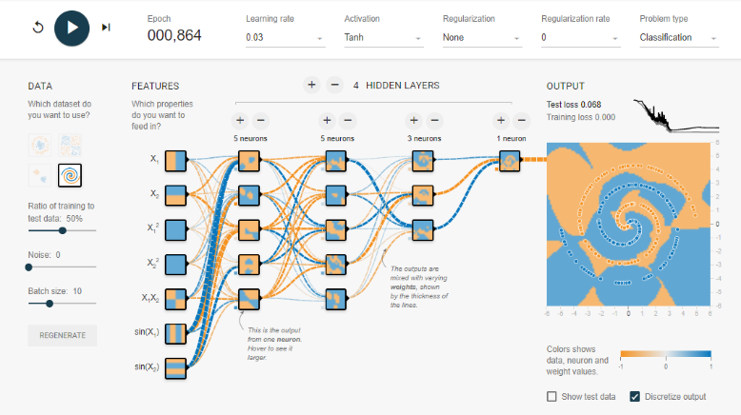
TensorFlow Playground – Neural Network
https://playground.tensorflow.org

Slide 18
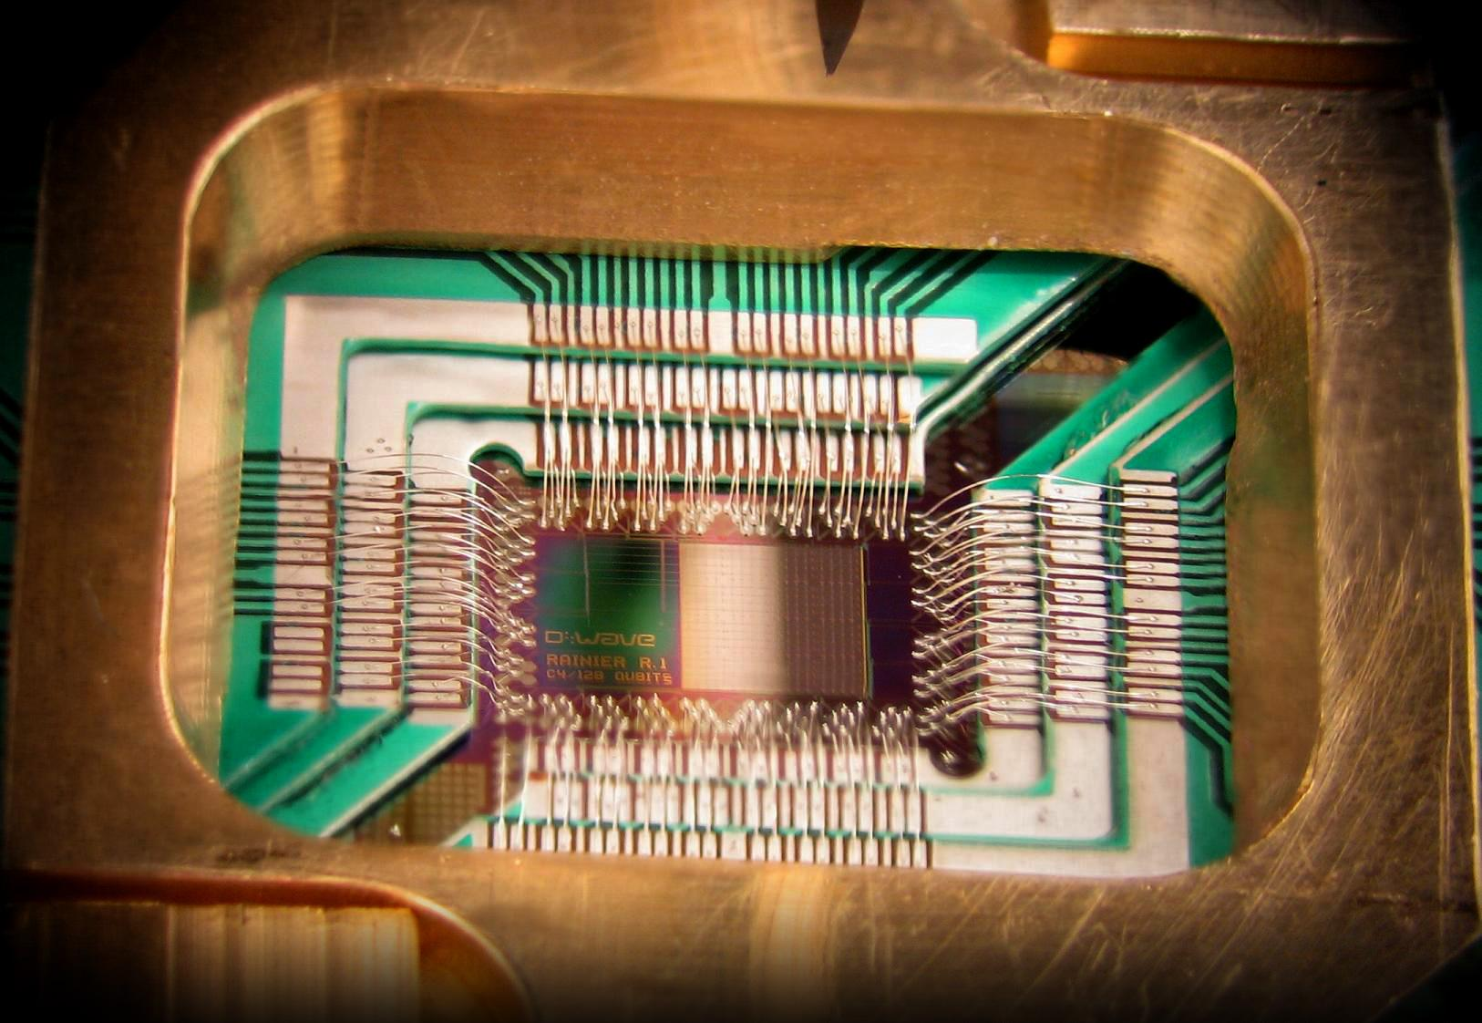
Quantum Computing
Entangled quantum states
Qbit can be in both a true and false state simultaneously
Multiple entangled bits can be in 2^{n} states
Operate at temperatures 0 K
D-Wave
128 bits
Uses Josephson Junctions
May not be true quantum computing

Slide 19
Quantum Computing at Google AI
https://ai.google/research/teams/applied-science/quantum-ai/

Slide 20
Limitations of Machine Learning
There is bias in the programming and training data sets.
Improvement in performance is asymptotic in nature.
Current methods do not generalize well to novel situations.
Images can be misidentified (Adversarial images)
It acts as a black box and makes it difficult to validate reliability.
It needs a superset of knowledge to provide context for understanding.
What does it mean to ‘understand?’

Slide 21
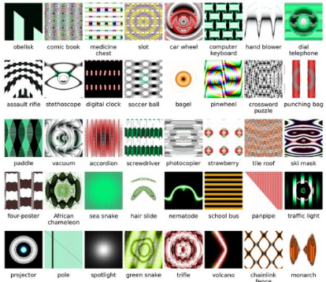

Slide 22
Impact on the Professions
What is a profession?
Embody expertise, experience and judgment.
Make this service accessible in an affordable manner
Ensure the quality of the service by being up-to-date, training members and enforce standards of quality
Act with honesty, in good faith, putting interests of clients ahead of their own
Examples
Lawyers
Doctors
Educators
How will the professions change as technology changes?
Are there new ways of organizing professional work to make it more affordable, accessible and reliable?
If professional work can be broken down into more basic tasks, could the more repetitive and routine aspects be distributed to different modes of delivery?
Can the professionals themselves be tasked with evaluating (reimagining) themselves and determining what should be retained in the profession and what can be distributed to non-professionals?
Is the grand bargain actually working? Are the professions fit for their purpose and are they serving society well?

Slide 23
Impact on Society
Ethical Issues
Privacy – What is public and private knowledge when combing the web? (Search warrants)
Liability – Who is responsible: the programmer, trainer or owner? (Self-driving cars)
Freedom in society – Who acts as the gatekeepers of information? (Google Project Dragonfly)
Automation of security – In life and death situations, can AI be trusted? (Drones)
Bias free AI – Can and should AI be developed without any human bias? (Training databases)
Who determines the basis of morality upon which AI will operate?
Are Asimov’s 3 Laws of Robotics sufficient?
A robot may not injure a human being or, through inaction, allow a human being to come to harm.
A robot must obey the orders given it by human beings except where such orders would conflict with the First Law.
A robot must protect its own existence as long as such protection does not conflict with the First or Second Laws.
Notes:
1942 short story “Runaround” by Isaac Asimov

Slide 24
AI and the Image of Man
In Our Image – Artificial Intelligence and the Human Spirit, Noreen Herzfeld (2002)
Why does man want to create in his image (Imagio hominis) and what implications does it have for the image of God (Imagio Deo)?
Three views on the Image of God
Substantive Approach (Reinhold Niebuhr)
There is something to man that is beyond the physical and this may be expressed as 'Reason.'
Functional Approach (Gerhard von Rad)
Man plays the role of regent for God. This regency is a functional role and does not imply that man has any special qualities beyond the physical.
Relational Interpretation (Karl Barth)
Man is defined only by his relationships with God and with other man. The Triune God is relational and mankind is expressing the Image of God when he acts in relationship.
Barth says that Image of God is when we can look eye to eye, speak and hear each other, give to each other and do it willingly.

Slide 25
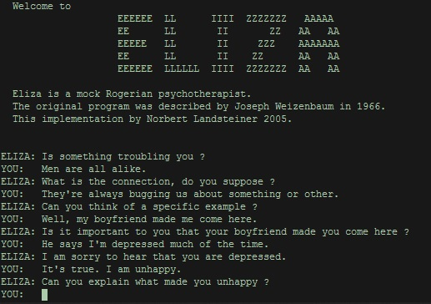
Joseph Weizenbaum
ELIZA – Natural language processing program
MIT Artificial Intelligence Laboratory (1964-66)
Use approach of Rogerian psychotherapist
Weizenbaum’s commentary on ELIZA
“the illusion of understanding with so little machinery”
“the crucial test of understanding … (is) … to draw valid conclusions from what he is being told.”
Notes:
Weizenbaum, J. 1966. Computational linguistics. Communications of the ACM 9: 36-45.

Slide 26
Final Comment
Computer Power and Human Reason, Weizenbaum (1976)
“They have, with few exceptions, reserved for themselves the right to make decisions based on the outcome of such computing processes. People are thus able to maintain the illusion, and it is often just that, that they are after all the decision makers. But, as we shall argue, a computing system that permits the asking of only certain kinds of questions, that accepts only certain kinds of “data,” and that cannot even in principle be understood by those who rely on it, such a computing system has effectively closed many doors that were open before it was installed. (page 38)
The role of mankind to interpret and understand the world is uniquely human and should not be abdicated to automated processes!
AI and machine learning are useful tools and must be understood and used appropriately.
Notes:
Weizenbaum, J. 1976. Computer power and human reason: from judgment to calculation. San Francisco: W.H. Freeman and Co.
Quote from page 38

Slide 27
Recommended Books
Computer Power and Human Reason, Joseph Weizenbaum
Godel, Escher, Bach: An Eternal Golden Braid, Douglas Hofstadter
The Future of the Professions: How technology will transform the work of human experts, Richard and Daniel Susskind
In Our Image – Artificial Intelligence and the Human Spirit, Noreen Herzfeld

Slide 28
Abstract
What is artificial intelligence (AI) and its prospects for the future? To answer these questions a half-century history of AI is presented along with the current state of AI. Its future is contingent on its limitations and its impact on society. Although there is talk of an “AI bubble burst,” the future of AI and data science in general is very promising.

